Slide 1
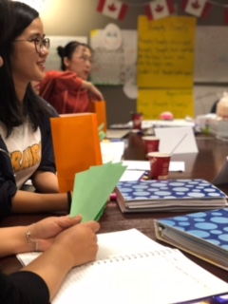
5-Star Teacher Institute
PROFESSIONAL DEVELOPMENT
a Canadian approach to learning
North Star Academy Laval, Quebec, Canada
www.northstaracademy.ca

Slide 2
INTRODUCTION
North Star Academy Laval is a suburban English high school that prides itself in excellent teaching practices.
Students come to school with pen, pencil or tablet in hand, ready to learn in so many diverse ways.
Known for our small class sizes, we focus on individualized learning and customized tutorials guiding students to develop at their own pace, within high academic standards.
Bringing the world to our students and our students to the world is a key focus of our school--through diverse extra-curricular activities which help round out their education, and by connecting students with community action through projects, volunteering, visits, trips—learning to become active citizens in a community.
We teach not only for school but for life!
PROGRAM STRUCTURE
Our approach through the five days is a movement between theory and practice.
We will explore the foundational theories upon which the Canadian education systems are built.
Provide teachers with an opportunity to see some of these elements put into practice, in our classrooms.
Arrival
Cultural
Tour
DAY 1
Class
DAY 2
School
Visit
DAY 3
Class
DAY 4
School
Visit
DAY 5
Class
Graduation

Slide 3
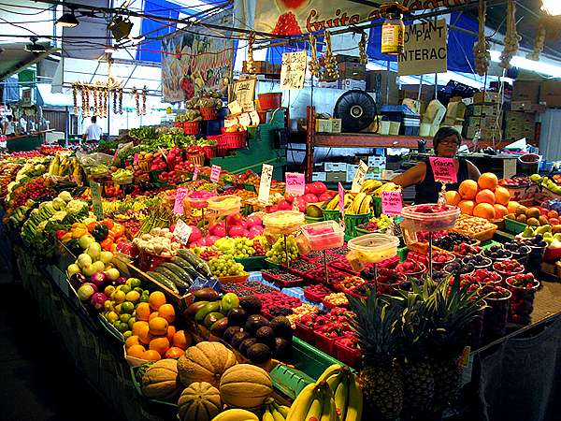
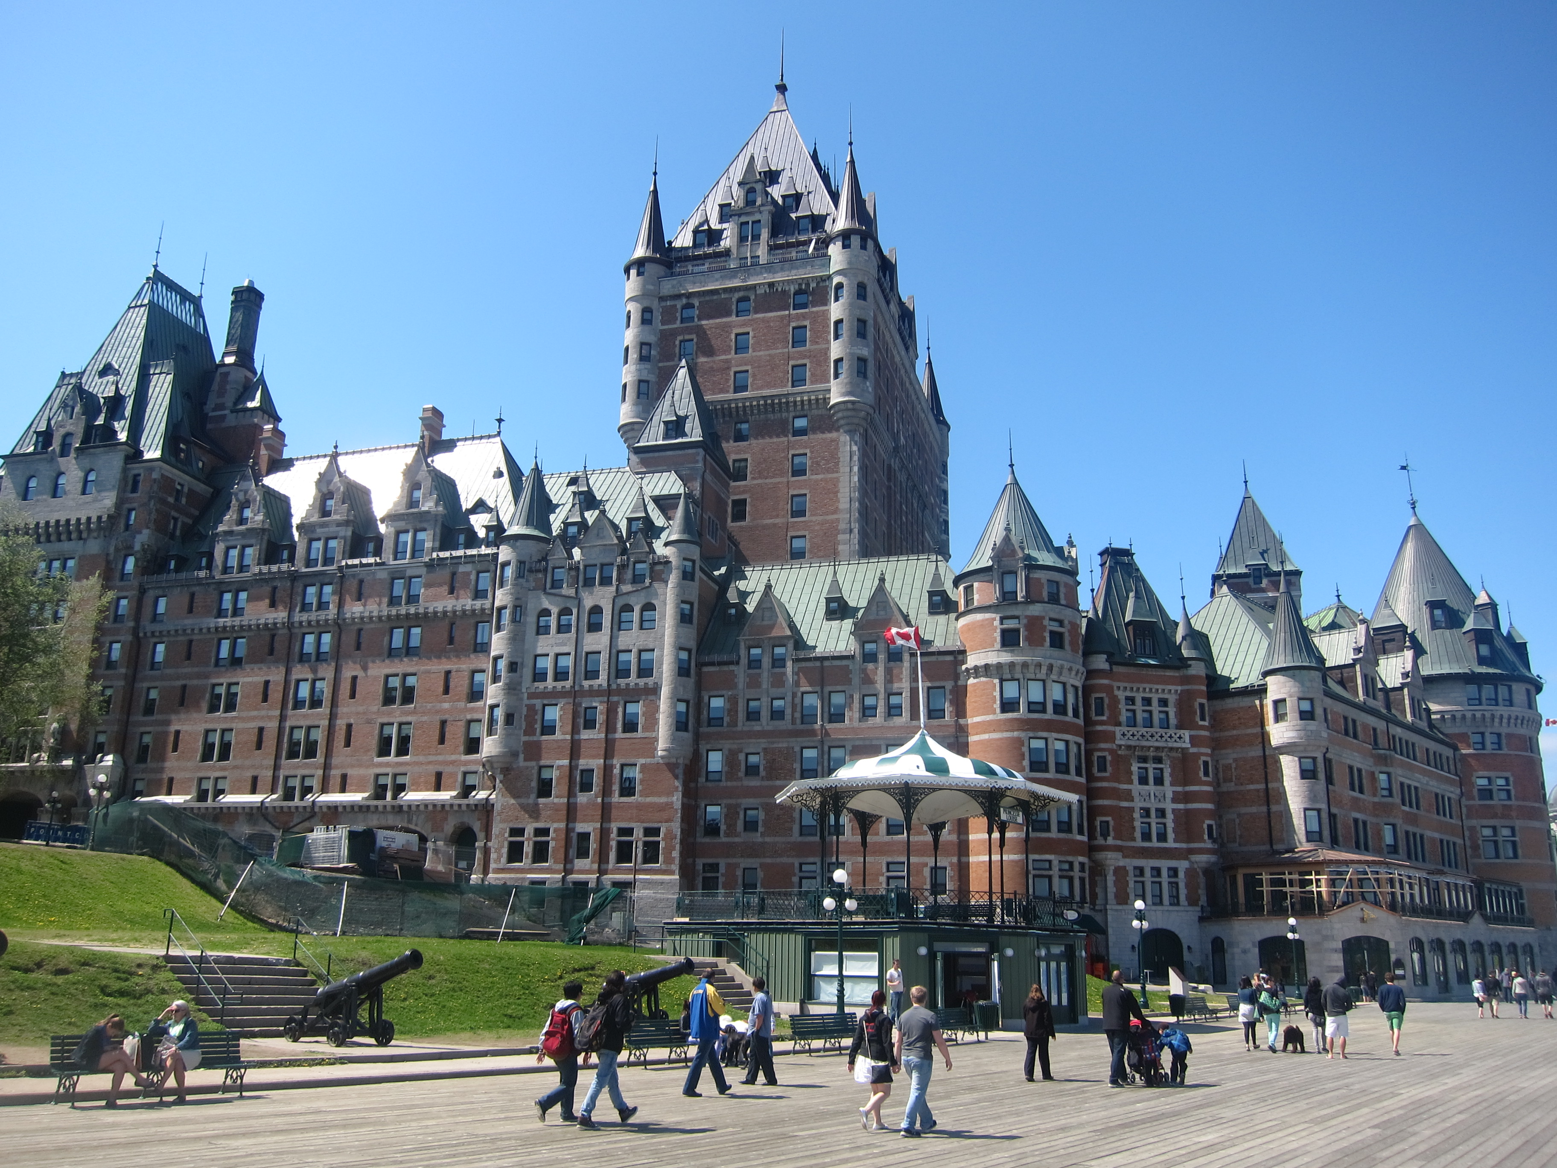
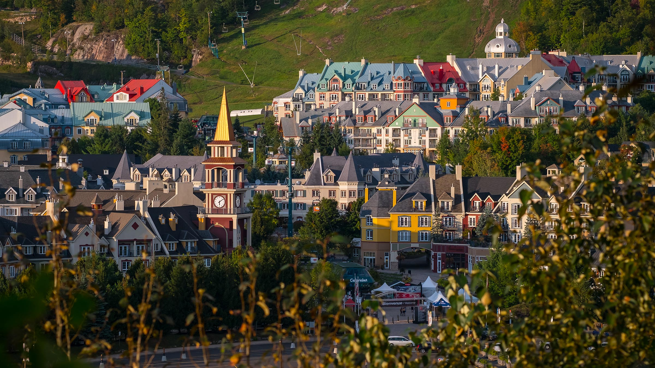
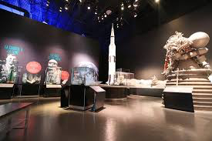
PROGRAM STRUCTURE
The Program is a combination of Canadian cultural immersion and education
Our approach through the five days of learning is a movement between theory and practice.
We will explore the foundational theories upon which the Canadian education systems are built.
Provide teachers with an opportunity to see some of these elements put into practice, in our classrooms.
Arrival
Cultural
Tour
DAY 1
Class
DAY 2
School
Visit
DAY 3
Class
DAY 4
School
Visit
DAY 5
Class
Graduation
Cultural
Tour
Departure
CANADIAN CULTURAL IMMERSION
Cultural immersion is an important part of the program.
Two touring days are scheduled through our
TLC—TASTE LOCAL CULTURE signature program:
Day-trips to two of the following:
★ Downtown Montreal
★ Quebec City
★ Ottawa
3 evenings participants will have an opportunity to experience local culture through a choice of activities, depending on the season:
market visits,
space center,
Ice-Skating,
Shopping,
Restaurants, etc.

Slide 4
Welcome
歡迎
North Star Academy Laval where we:
Prioritizing each student, each day.
©2018 North Star Academy Laval

Slide 5
我們的學校
Our School
120 Students 15-30 Int’l Students
North Star Academy Laval is a suburban English high school that prides itself in teaching to our 21st century students. Students come to school with pen, pencil or tablet in hand, ready to learn in so many diverse ways. Known for our small class sizes, we focus on individualized learning and customized tutorials guiding students to develop at their own pace, within high academic standards. Bringing the world to our students and our students to the world is a key focus of our school--through diverse extra-curricular activities which help round out their education, and by connecting students with community action through projects, volunteering, visits, trips—learning to become active citizens in a community. We teach not only for school but for life!
21 Staff
Grades 7-12
Class size: 10-22
©2018 North Star Academy Laval

Slide 6
我們的學校
Our School
Each student, each day—no one can be left behind or lost in the shuffle with small class sizes and a staff team approach to educating each student in every grade.
Safe and secure—knowing your child is in good hands in high school is the peace of mind our parents look for in a school.
Keeping them motivated—opportunities abound form weekly Extra-Curricular activities in–house; to guest speakers who make connections between learning and earning; to volunteering and community visits; and competitive contests keeping them engaged—there is something for everyone.
Engaging them in class—From clear goals to differentiated curricula and teaching strategies—our staff work endlessly to make learning enticing for each type of learner.
Partners in education—parents are our partners, we have a simple to use communication system, call, email or message us. We know that it takes a team to help guide a 21st Century Teen towards adulthood.
Enrich their lives—from local volunteering to travel in Canada and abroad, our students experience a taste of the world through various lenses as they continue to grow and learn about themselves in these key years of their lives.
Give them an advantage—all our students graduate and successfully enter college.
©2018 North Star Academy Laval

Slide 7
Our Signature 5-Day
International Teacher Professional Development Program
THEORY
You will learn about foundational Canadian approaches to teaching students in the 21st Century classroom in a professional learning setting.
PRACTICE
You will observe and see what we discussed in the classroom with Canadian teachers and have an opportunity to discuss with them any questions you may have.
Welcome to the North Star Academy
5-Day Signature program developed for trained teachers from around the world.
Our approach through the five days is a movement between theory and practice. We will explore the foundational theories upon which the Canadian education systems are built and provide you with an opportunity to see some of these elements put into practice, in our classrooms.
©2018 North Star Academy Laval

Slide 8
5 Day Outline
AUG 27
❶
Theory
❷
Practice
AUG 28
AUG 29
Theory
❸
❹
Practice
AUG 30
AUG 31
Theory
❺
©2018 North Star Academy Laval

Slide 9
Topic Outline
Theory
Overview of Quebec Education System
A competency-based approach
Fundamentals of 21st Century learning
Preparation for school observations
❶
9am-1:30 pm
AUG 27
Practice
❷
School Tour
Classroom observations
Lunch with teachers
Meeting to discuss and question
AUG 28
9am-1:30 pm
Theory
9am-1:30 pm
AUG 29
Positive classroom management
Learning styles
Differentiation
❸
Practice
❹
Classroom observations
Lunch with teachers
Meeting to discuss and question
AUG 30
9am-1:30 pm
Theory
9am-1:30 pm
AUG 31
❺
Student centered lesson planning
Curriculum Mapping the school year
©2018 North Star Academy Laval

Slide 10
Day
❶
Theory
9am-12:00 pm
AUG 27
Overview of Quebec Education System
A competency-based approach
Fundamentals of 21st Century learning
-Multiple Intelligences
-Bloom’s Taxonomy
-Visible Learning
Preparation for school observations

Slide 11
Goals and Strategies
Use a blended learning model
Experience the learning and activities
Identify resources to help you implement change
Understand learning theory of a 21st Century classroom
Apply the theory within learning frameworks
Identify theory in NSA classroom practices

Slide 12
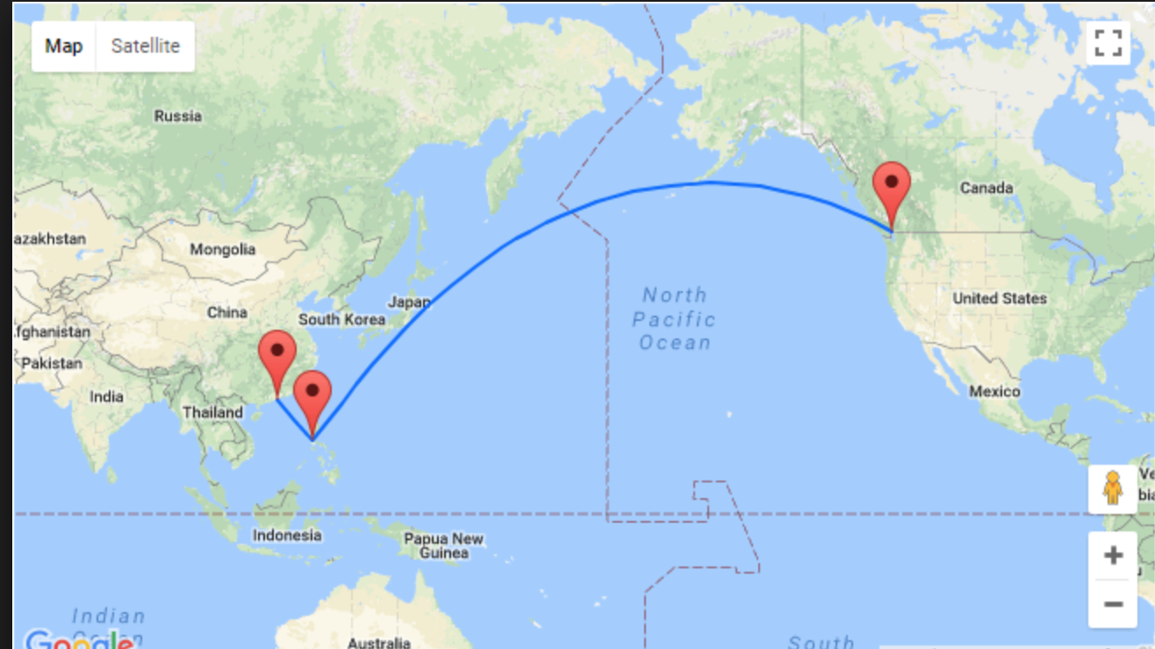
From CHINA to CANADA!

Slide 13
21st Century Education
Notes:
https://www.youtube.com/watch?v=zDZFcDGpL4U

Slide 14
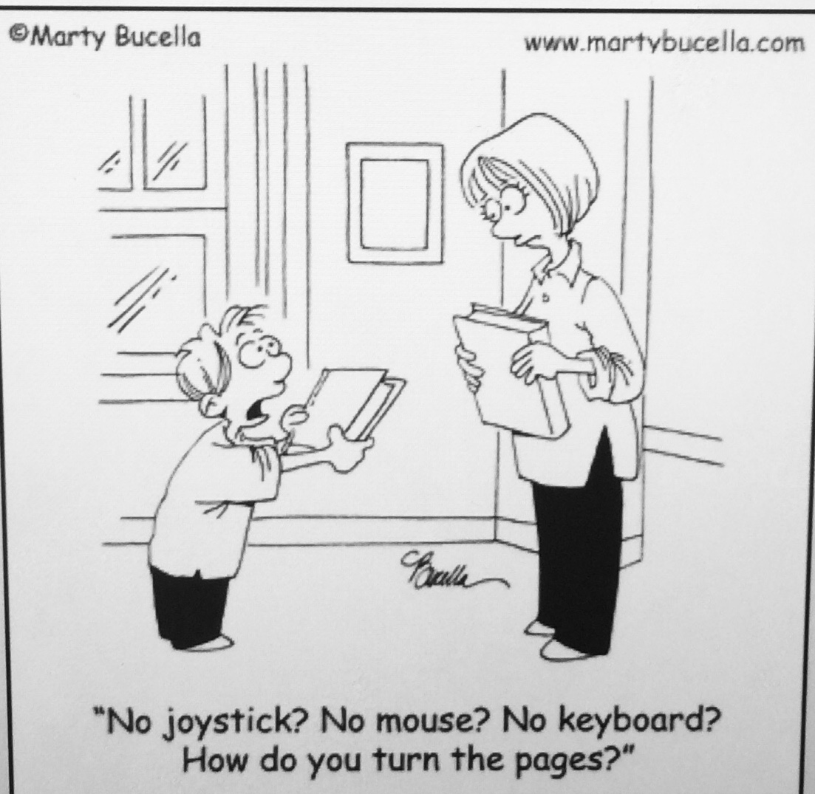
Connect the DOTS
How are students in China different today, than when you were an elementary student?
Notes:
Ok, let’s connect the dots
Question:
How are students in China different today than when you were a child?
Gather a few comments verbally
T chart
Educators are now finding that today’s students on one hand….
Don’t use their imaginations as much for entertainment
Are less physically active and play less outdoor games
Seldom read books for entertainment
Have smaller vocabularies
Write short communications
Demonstrate weaker spelling abilities
Prefer to print than handwrite
On the other hand…..
Have better hand/eye coordination and fine motor skills
Use technology tools to create highly interesting and informed projects that include sound, video and other interactive features
Have more foreknowledge about topics than other generations
Apply theoretical knowledge because they learn by doing and application
Are more adaptable and interdependent

Slide 15
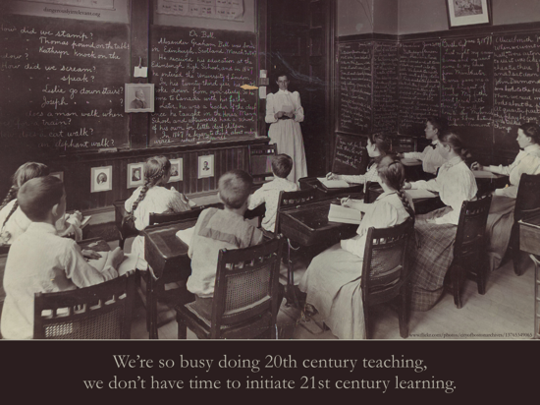
9:30-9:45 21st Century Classroom
21st Century Learners
Notes:
So...CLICK...the difficult cognitive dissonance, regardless of your age that you face as a teacher is—not re-teaching solely in the ways you learned and were taught—because the resources and technologies did not exist to the degree they do today.
If you are busy doing 20th Century stuff, the school day and year has not gotten longer, so how will you find time for 21st century learning? we are after all 18 years into this century. Has enough changed (let this comment hang)

Slide 16
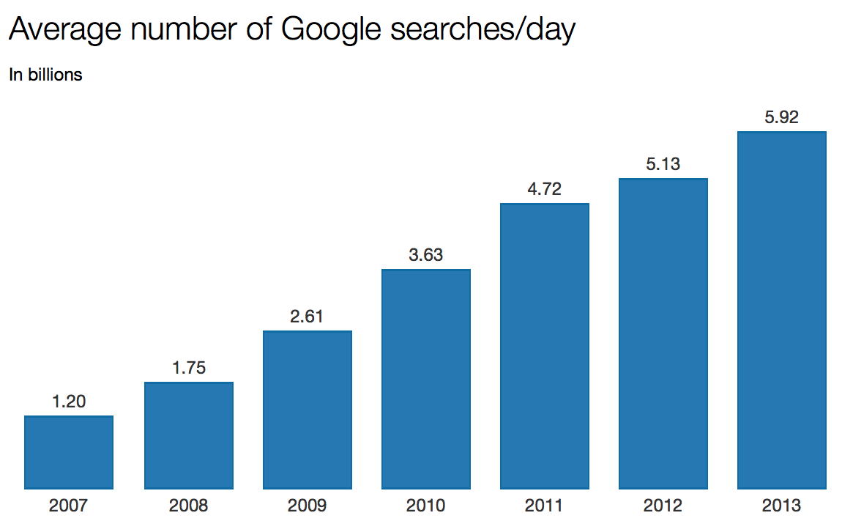
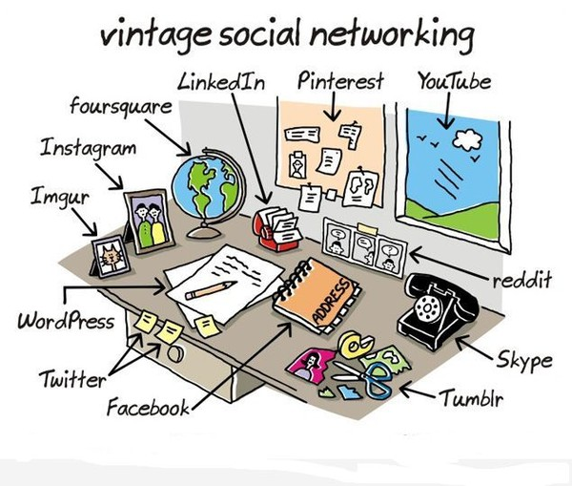
9:20-9:35 21st Century Classroom
21st Century Learners
Notes:
Research informs us that our brains, and especially childrens’ brains, are developing and reacting differently today due to screen media usage
In addition, our world around us is undergoing tremendous rapid changes
How do these realities shape 21st learners in your classroom?
21st Century Learners are becoming more and more:
-globally aware
-communicators—oh sure, maybe not with their parents, but you and I know that texting and messaging are their preferred tool for communication—something to keep in mind
-problem solvers—they are more informed through media and the web of what is out there and want to have a say at solutions
-information and media literate—but not always savvy—how can we help them take what they know about technology and use it for learning and communicating in school—without dampening the enthusiasm?
and
-they are the innovative generation, along with many other characteristics
Our world, depending on your age, looked more like this
CLICK—vintage social media
Their world looks like this:
Collage of tools they use—these are not add on’s for them—they are no different than a pen, pencil or hammer—they are tools they grew up with—they know no other world

Slide 17
21st Century Classroom
Be learner centered and more personalized
Provide students with opportunities to feature and produce evidence of their new knowledge in a variety of ways
Help make connections between class learning and world and their interests
Provide opportunities to explore & use new technologies as learning tools
Go global – take virtual field trips, conduct virtual student exchanges around the world
Go digital--Go paperless for some work
Collaborate via technology (student – teacher, student- parent, teacher-parent)
Project based learning, etc.
Notes:
In today’s classrooms, instruction needs to move towards….
Be learner centered and more personalized
Provide students with opportunities to feature and produce evidence of their new knowledge in a variety of ways
Help make connections between class learning and world and their interests
Provide opportunities to explore & use new technologies as learning tools
Go global – take virtual field trips, conduct virtual student exchanges around the world
Go digital--Go paperless for some work
Collaborate via technology (student – teacher, student- parent, teacher-parent)
Project based learning, etc.
It’s all about connecting with students and engaging them as active partners in their learnring!

Slide 18
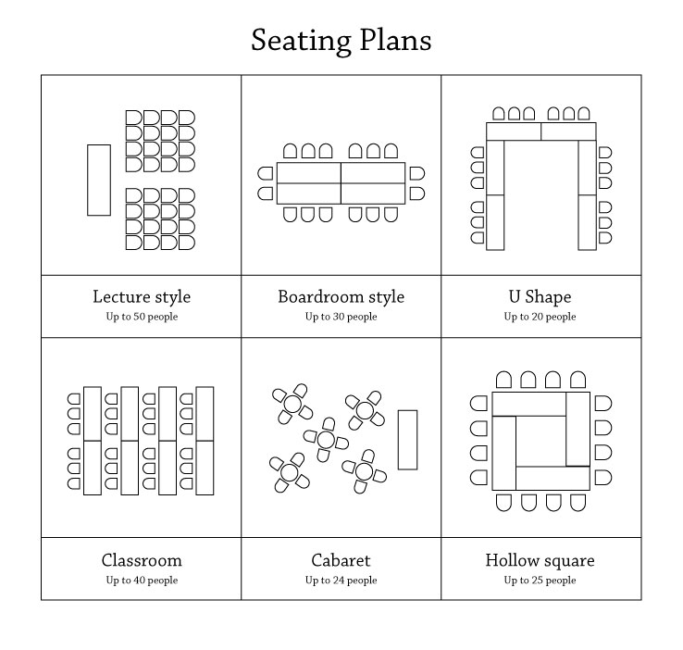
21st Century Education
Notes:
https://www.youtube.com/watch?v=zDZFcDGpL4U

Slide 19
21st Century Education
Notes:
https://www.youtube.com/watch?v=zDZFcDGpL4U

